Slide 1

News, November 2014

Slide 2
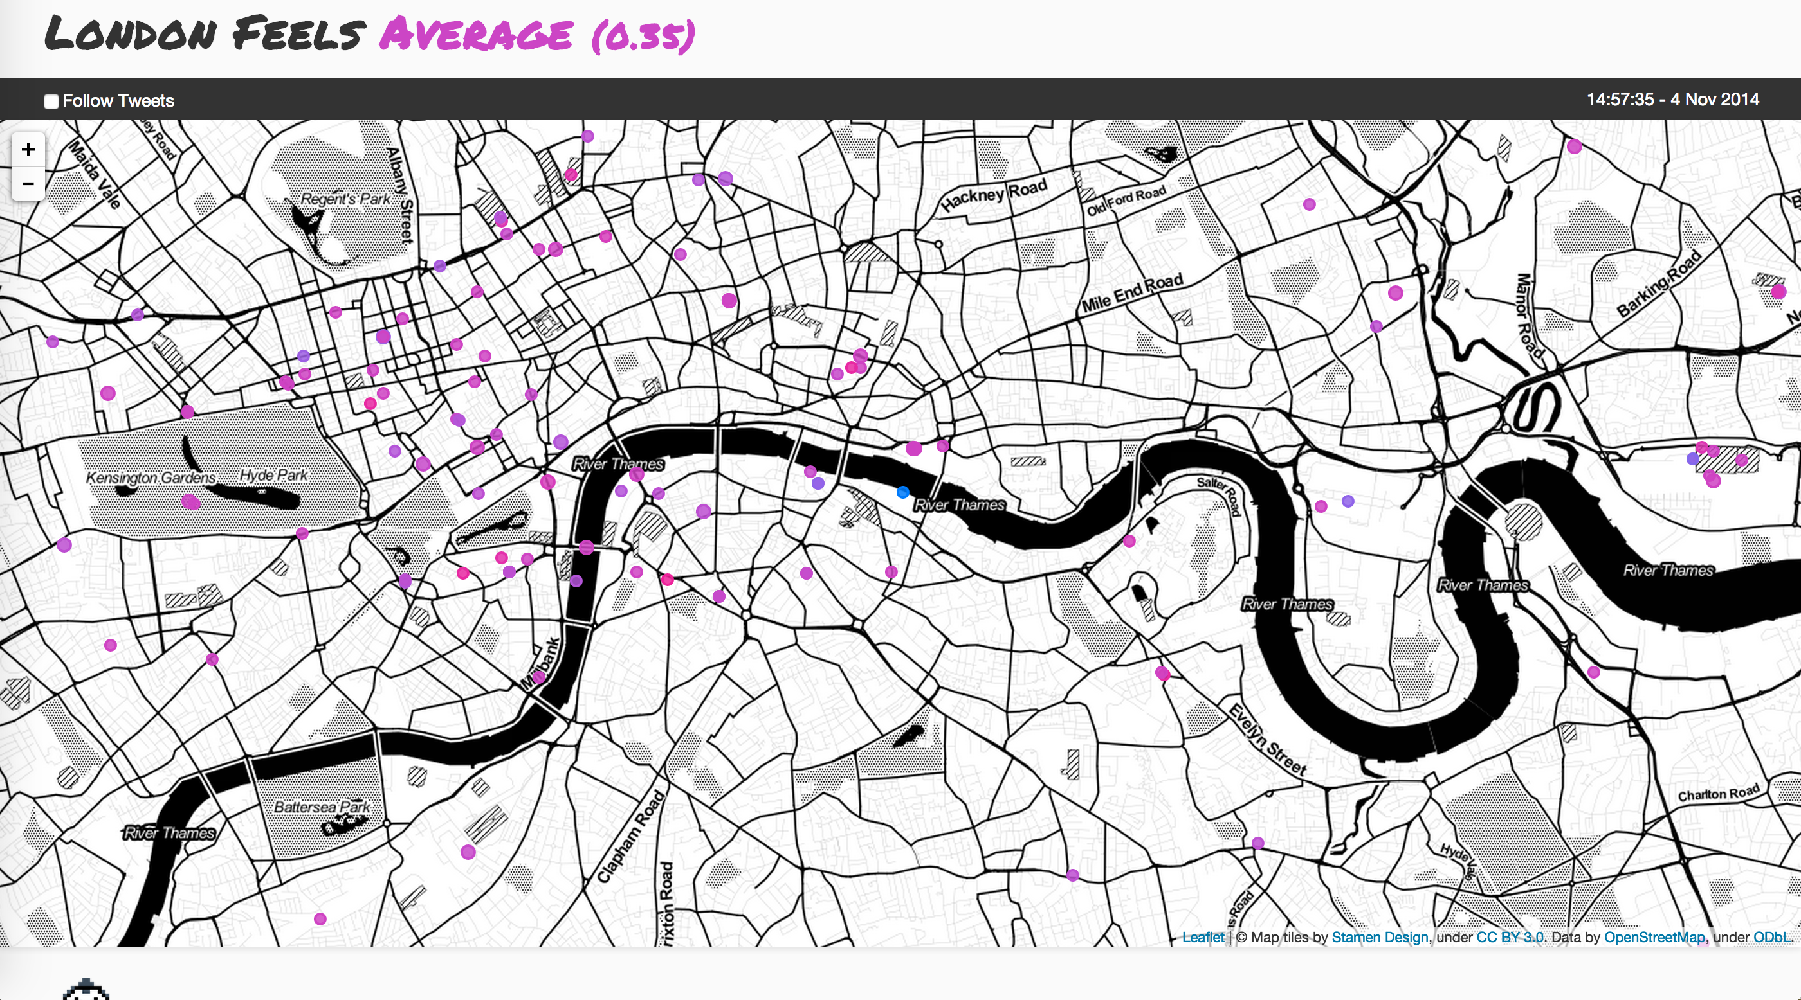
London’s in the mood!
http://london.feels.website/

Slide 3
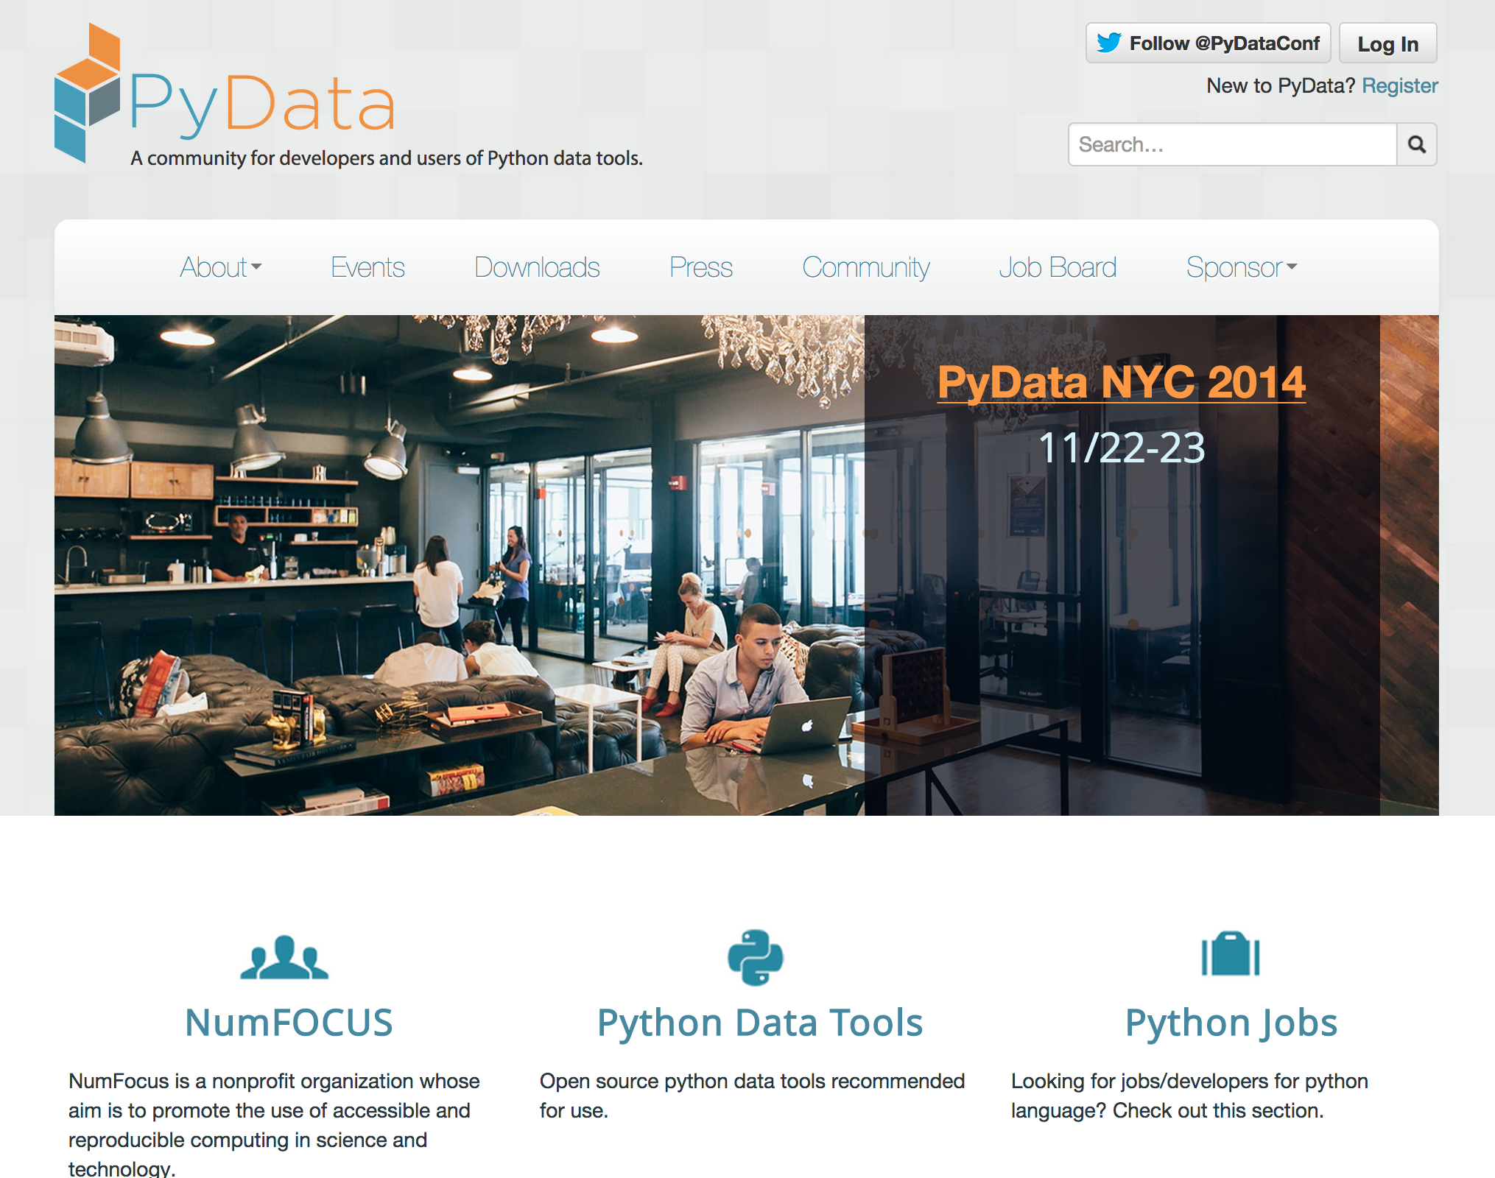
PyDataNewYork – 22nd November

Slide 4
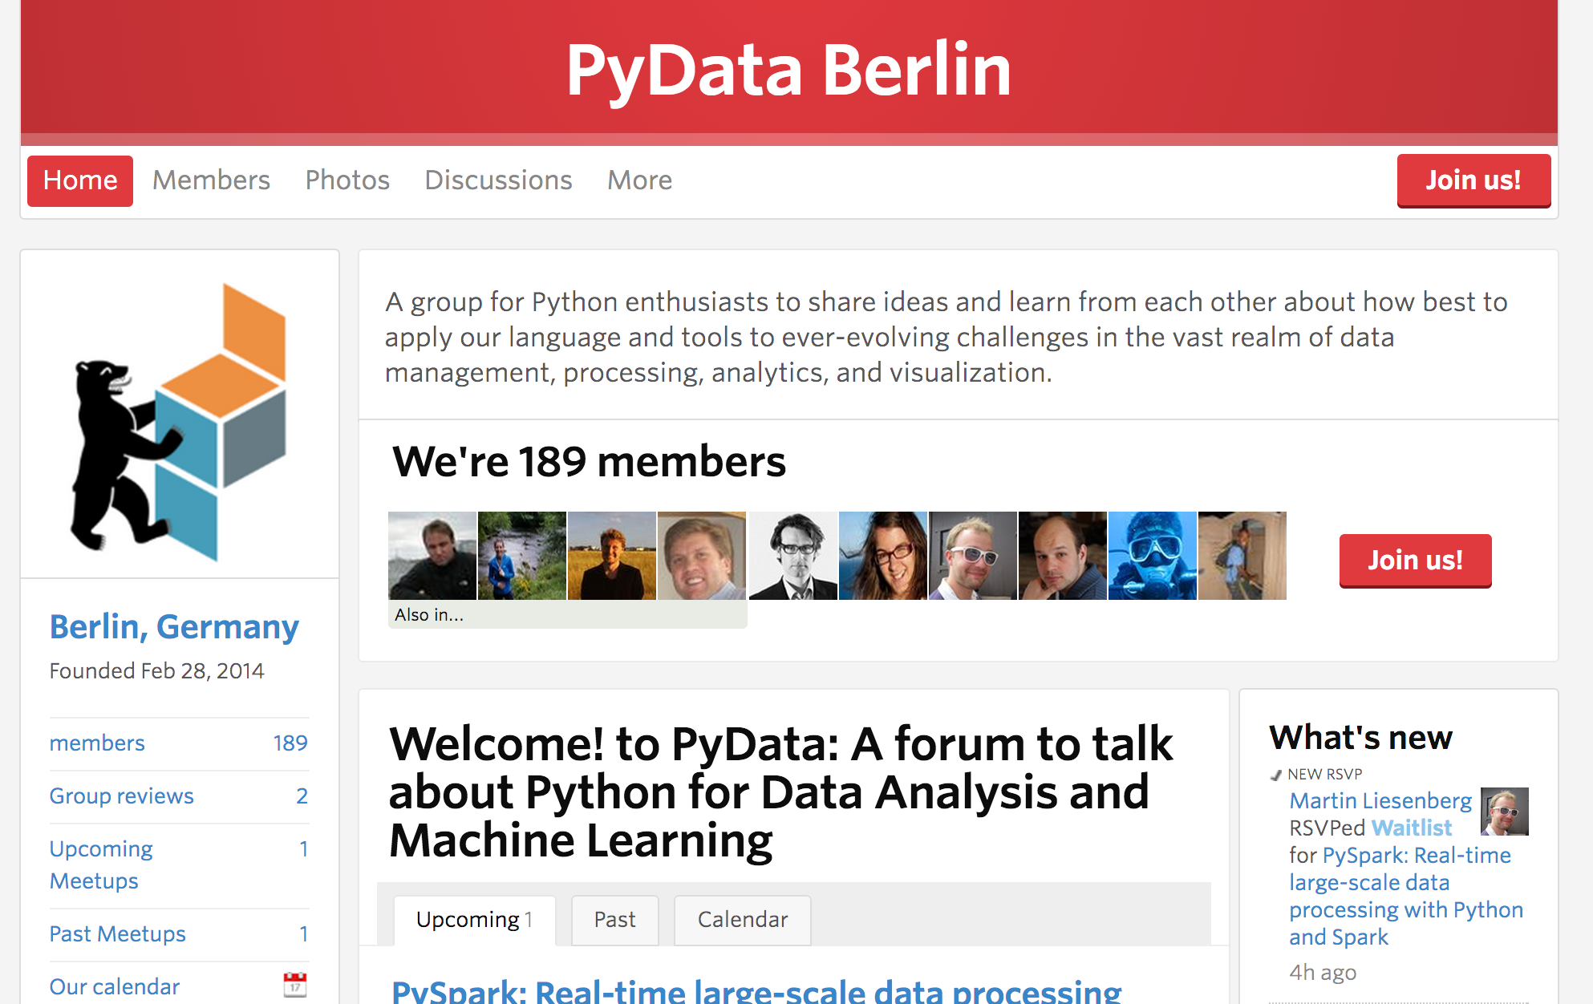
PyDataBerlin — they have a meetup!

Slide 5
Correlation Matrix — what do we find?
 | Title | Member ID | Total RSVPs | RSVPed Yes | RSVPed Maybe | RSVPed No | Meetups attended | No shows
Title | nan | nan | nan | nan | nan | nan | nan | nan
Member ID | nan | 1 | -0.16 | -0.16 | nan | -0.07 | -0.14 | -0.11
Total RSVPs | nan | -0.16 | 1 | 0.8 | nan | 0.67 | 0.72 | 0.23
RSVPed Yes | nan | -0.16 | 0.8 | 1 | nan | 0.09 | 0.87 | 0.34
RSVPed Maybe | nan | nan | nan | nan | nan | nan | nan | nan
RSVPed No | nan | -0.07 | 0.67 | 0.09 | nan | 1 | 0.13 | -0.03
Meetups attended | nan | -0.14 | 0.72 | 0.87 | nan | 0.13 | 1 | -0.04
No shows | nan | -0.11 | 0.23 | 0.34 | nan | -0.03 | -0.04 | 1

Slide 6
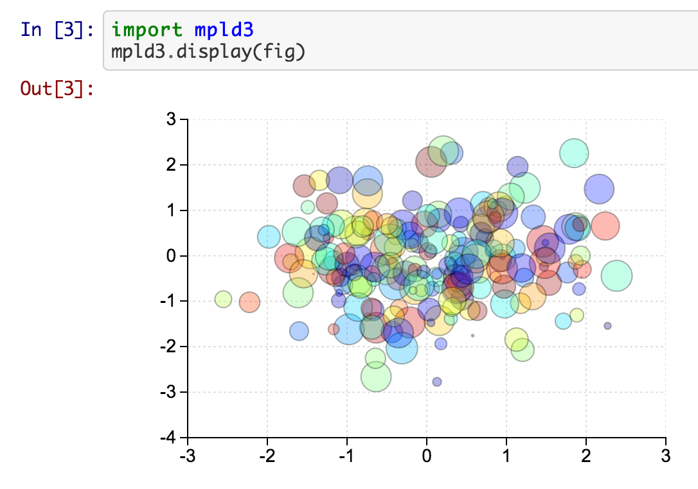
POTM: mpld3, matplotlib-d3
An API complete way to use D3 with Matplotlib
mpld3.display(figure) — that’s all you need!
http://mpld3.github.io/

Slide 7
PyData London 2015!!!!

